Slide 1
CS 3006 Parallel and Distributed Computing Lecture 11
Danyal Farhat
FAST School of Computing
NUCES Lahore

Slide 2
Synchronization Constructs in OpenMP

Slide 3
Outline
Synchronization Clauses
Barrier Directive
Single Directive
Master Directive
Critical Section
Race Condition
Atomic Directive

Slide 4
Outline (Cont.)
Environment Variables in OpenMP
OMP_NUM_THREADS
OMP_DYNAMIC
OMP_Dynamic [dynamic.c]
OMP_SCHEDULE
OMP_NESTED
OMP_NESTED [nested.c]
Home Task
Summary
Additional Resources

Slide 5
Synchronization Clauses
#pragma omp barrier
#pragma omp single
#pragma omp master
#pragma omp critical
#pragma omp atomic
#pragma omp ordered
#pragma omp flush[(list)]
#pragma omp threadprivate(variable list)

Slide 6
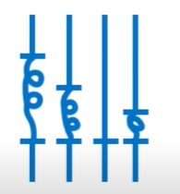
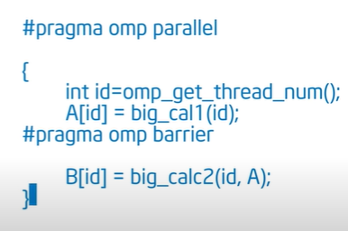
Barrier Directive
On encountering this directive, all threads in a team wait until others have caught up, and then release
#pragma omp barrier

Slide 7
Single Directive
A single directive specifies a structured block that is executed by a single (arbitrary) thread in parallel region
Implicit barrier
#pragma omp single [clause list]
structured block

Slide 8
Master Directive
The master directive is a specialization of the single directive in which only the master thread executes the structured block
No implicit barrier
#pragma omp master
structured block

Slide 9
Critical Section
A Critical Section is a code segment that has a shared variable and need to be executed as an atomic action
It means that in a group of cooperating processes/threads, at a given point of time, only one process must be executing its critical section
#pragma omp critical
An operation acting on shared memory is atomic if it completes in a single step relative to other threads (no other thread can observe the modification half-complete}
Notes:
GNU is an operating system.

Slide 10
Critical Section (Cont.)
Forces threads to be mutex (mutually exclusive)
Only one thread at a time executes the given code section
double area, pi, x;
int i, n;
...
area = 0.0;
for (i = 0; i < n; i++) {
x += (i+0.5)/n; //can be calculated independently
area += 4.0/(1.0 + x*x); //requires mutex lock
}
pi = area / n;
Notes:
GNU is an operating system.

Slide 11
Critical Section (Cont.)
If we simply parallelize the loop... A race condition may occur
double area, pi, x;
int i, n;
...
area = 0.0;
#pragma omp parallel for private(x)
for (i = 0; i < n; i++) {
x = (i+0.5)/n;
area += 4.0/(1.0 + x*x); //not atomic
}
pi = area / n;
Notes:
GNU is an operating system.

Slide 12
Critical Section (Cont.)
Race Condition
Thread A reads value of area first
Thread B reads value of area before A can update its value
Thread A updates value of area
Thread B ignores update by A and writes its incorrect value to area

Slide 13
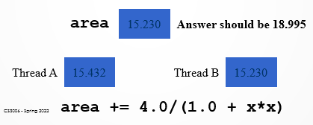
Critical Section (Cont.)
Race Condition
A race condition is created when one process may “race ahead” of another and overwrite the change made by the first process to the shared variable
Notes:
GNU is an operating system.

Slide 14
Critical Section (Cont.)
Critical section: a portion of code that only thread at a time may execute
We denote a critical section by putting the pragma
#pragma omp critical [(name)]
Optional identifier name can be used to identify a critical region
Solves the problem but, as only one thread at a time may execute the statement; it becomes sequential code
Notes:
GNU is an operating system.

Slide 15
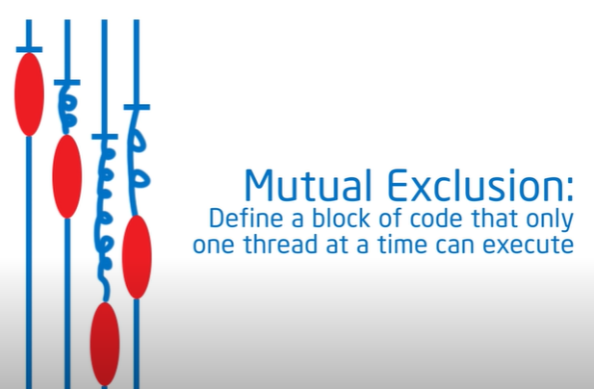
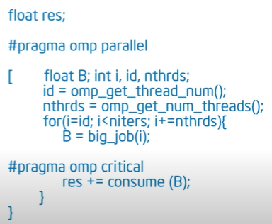
Critical Section (Cont.)
Critical Section:
double area, pi, x;
int i, n;
area = 0.0;
#pragma omp parallel for private(x)
for (i = 0; i < n; i++) {
x = (i+0.5)/n;
#pragma omp critical
area += 4.0/(1.0 + x*x);
}
pi = area / n;

Slide 16
Atomic Directive
The atomic directive specifies that the single memory location update should be performed as an atomic operation
#pragma omp atomic
Update instruction e.g., x++

Slide 17
Atomic Directive (Cont.)
#pragma omp parallel for
{
for (i=0; i++, i<n)
{
#pragma omp atomic // Shortcut for critical section
ic = ic + bigfunc(); // Little faster than critical overhead
}
printf("counter = %d\n", ic);
}
Supported functions
+, *, -, /, &, ^, |, <<, >>

Slide 18
Environment Variables in OpenMP
OpenMP provides additional environment variables that help control execution of parallel programs
OMP_NUM_THREADS
OMP_DYNAMIC
OMP_SCHEDULE
OMP_NESTED

Slide 19
Environment Variables in OpenMP (Cont.)
OMP_NUM_THREADS
Specifies the default number of threads created upon entering a parallel region
The number of threads can be changed during run-time using:
omp_set_num_threads (int threads) routine [OR]
num_threads clause ---> num_threads(int threads)
Setting OMP_NUM_THREADS to 4 using bash:
“export OMP_NUM_THREADS=4”

Slide 20
Environment Variables in OpenMP (Cont.)
OMP_DYNAMIC
When set to TRUE, allows the number of threads to be controlled at runtime
It means Openmp will use its dynamic adjustment algorithm to create number of threads that may optimize system performance
In case of TRUE, total number of threads generated may not be equal to the threads requested by using the omp_set_num threads() function or the num_threads clause
In case of FALSE, usually total number of generated threads in a parallel region become as requested by the num_threads clause

Slide 21
Environment Variables in OpenMP (Cont.)
OMP_DYNAMIC
OpenMP routines for setting/getting dynamic status:
void omp_set_dynamic (int flag); //disables if flag=0
Should be called from outside of a parallel region
int omp_get_dynamic (); //return value of dynamic status

Slide 22

OMP_Dynamic [dynamic.c]
workers = omp_get_max_threads(); //can use num_procs
printf("%d maximum allowed threads\n", workers);
printf("total number of allocated cores are:%d\n", omp_get_num_procs());
omp_set_dynamic(1); // dynamic adjustment enabled
omp_set_num_threads(8);
printf("total number of requested when dynamic is true are:%d\n", 1);
#pragma omp parallel {
#pragma omp single nowait
printf("total threads in parallel region1=%d:\n", omp_get_num_threads());
#pragma omp for
for (i = 0; i < mult; i++)
{a = complex_func();}
}

Slide 23
OMP_DYNAMIC [dynamic.c] (Cont.)
omp_set_dynamic(0); // dynamic adjustment disabled
omp_set_num_threads(8);
printf("total number of requested when dynamic is false are:%d\n", 8);
#pragma omp parallel
{
#pragma omp single nowait
printf("total threads in parallel region2=%d:\n", omp_get_num_threads());
#pragma omp for
for (i = 0; i < mult; i++)
{a = complex_func();}
}

Slide 24
Environment Variables in OpenMP (Cont.)
OMP_SCHEDULE
Controls the assignment of iteration spaces associated with “for” directives that use the runtime scheduling class
Possible values: static, dynamic, and guided
Can also be used along with chunk size [optional]
If chunk size is not specified, then default chunk-size of 1 is used
Setting OMP_SCHEDULE to guided with minimum chunk size of 4 using Ubuntu-based terminal:
“ export OMP_SCHEDULE= "guided,4” ”

Slide 25
Environment Variables in OpenMP (Cont.)
OMP_NESTED
Default value is FALSE
While using nested parallel pragma inside another, the nested one is executed by the original team instead of making new thread team
When TRUE
Enables nested parallelism
While using nested parallel pragma code inside another, it makes a new team of threads for executing the nested one.
Use omp_set_nested(int val) with non-zero value to set this variable to TRUE
When called with ‘0’ as argument, it set the variable to FALSE

Slide 26

OMP_NESTED [nested.c]
omp_set_nested(0);
#pragma omp parallel num_threads(2) {
#pragma omp single
printf("Level 1: number of threads in the team : %d\n", omp_get_num_threads());
#pragma omp parallel num_threads(4)
{
#pragma omp single
printf("Level 2: number of threads in the team : %d\n",
omp_get_num_threads());
}
}

Slide 27

OMP_NESTED [nested.c] (Cont.)
omp_set_nested(1);
#pragma omp parallel num_threads(2) {
#pragma omp single
printf("Level 1: number of threads in the team : %d\n", omp_get_num_threads());
#pragma omp parallel num_threads(4)
{
#pragma omp single
printf("Level 2: number of threads in the team : %d\n",
omp_get_num_threads());
}
}

Slide 28
Home Task
Provide the output of given code considering compiler will generate maximum 2 threads if dynamic adjustment is enabled.
workers = omp_get_max_threads(); //can use num_procs
printf ("%d maximum allowed threads\n", workers);
printf ("Total number of allocated cores are:%d\n", omp_get_num_procs());
omp_set_dynamic(1); // dynamic adjustment enabled
omp_set_num_threads(8);
printf ("Total number of requested when dynamic is true are:%d\n", 1);
#pragma omp parallel {
#pragma omp single nowait
printf("Total threads in parallel region1=%d:\n", omp_get_num_threads());
#pragma omp for
for (i = 0; i < mult; i++)
{a = complex_func();}
}

Slide 29
Home Task (Cont.)
omp_set_dynamic(0); // dynamic adjustment disabled
omp_set_num_threads(6);
printf("Total number of requested when dynamic is false are:%d\n", 6);
#pragma omp parallel
{
#pragma omp single nowait
printf("Total threads in parallel region2=%d:\n", omp_get_num_threads());
#pragma omp for
for (i = 0; i < mult; i++)
{a = complex_func();}
}

Slide 30
Summary
Synchronization Clauses
Barrier, single, master, critical, atomic etc.
Barrier Directive
On encountering this directive, all threads in a team wait until others have caught up, and then release
Single Directive
A single directive specifies a structured block that is executed by a single (arbitrary) thread in parallel region
Master Directive
The master directive is a specialization of the single directive in which only the master thread executes the structured block

Slide 31
Summary (Cont.)
Critical Section
A Critical Section is a code segment that has a shared variable and need to be executed as an atomic action
Race Condition
A race condition is created when one process may “race ahead” of another and overwrite the change made by the first process to the shared variable
Atomic Directive
The atomic directive specifies that the single memory location update should be performed as an atomic operation

Slide 32
Summary (Cont.)
Environment Variables in OpenMP
OMP_NUM_THREADS
OMP_DYNAMIC
OMP_Dynamic [dynamic.c]
OMP_SCHEDULE
OMP_NESTED
OMP_NESTED [nested.c]
Home Task

Slide 33
Additional Resources
Book: Introduction to Parallel Computing by Ananth Grama and Anshul Gupta
Chapter 7: Programming Shared Address Space Platforms
Introduction to OpenMP by Tim Mattson (Intel)
https://www.youtube.com/watch?v=nE-xN4Bf8XI&list=PLLX-Q6B8xqZ8n8bwjGdzBJ25X2utwnoEG&index=1

Slide 34
Questions?

